Slide 1
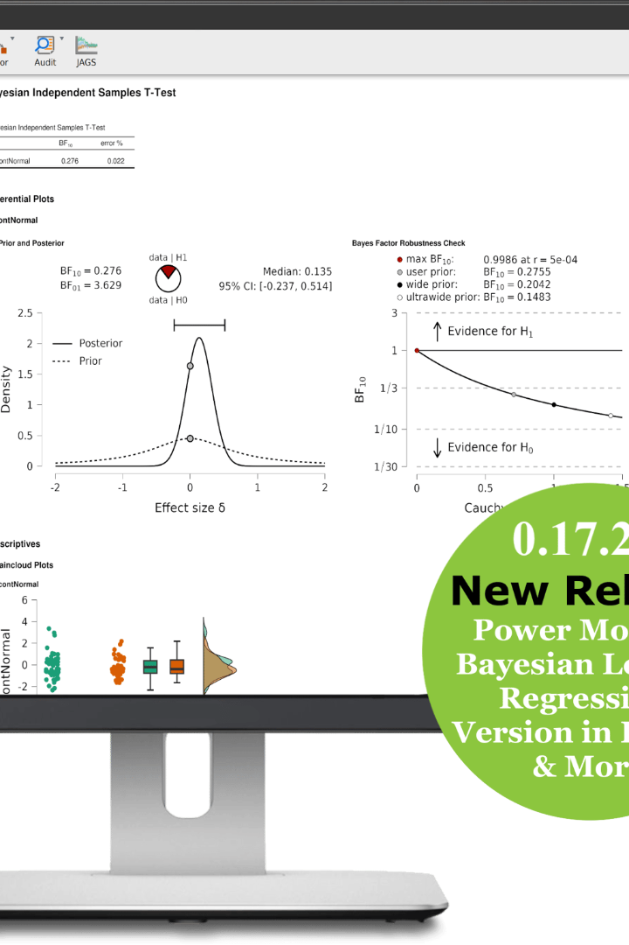
Maximizing Your Data Analysis with JASP and/or Jamovi
Unlock your statistical analysis skills with JASP and Jamovi. I'll introduce these powerful tools and demonstrate how to use them for effective data analysis. Compare them to Excel and RStudio to see how they stand out.

Slide 2
Enhancing Your Analysis Skills with BlueSky and Exploratory
Improve Your Analysis Techniques
Multiple Tools – Your choice
Take your analysis skills to the next level by using BlueSky and Exploratory. We'll guide you through live demonstration of their value.
This section will dive into a review of BlueSky, Exploratory, so you can choose which is right for you.

Slide 3
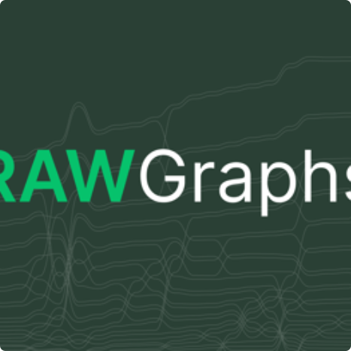
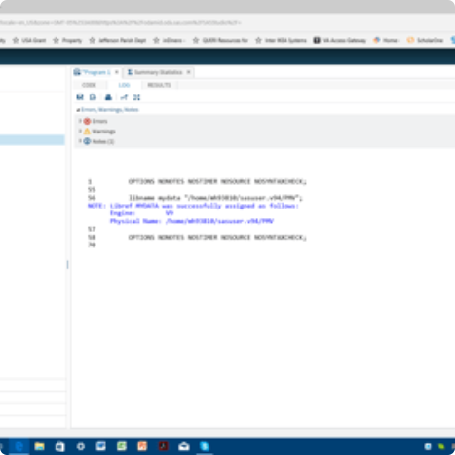
Advanced Data Visualization with RawGraphs | SAS OnDemand Intro
RawGraphs
SAS OnDemand
Get introduced to the basics of RawGraphs and learn about its advanced data visualization features.
Explore the vast potential of SAS OnDemand, including its capabilities for advanced data analysis.
Learn about raw data visualization with the help of RawGraphs and SAS OnDemand and get a glimpse of their rich features. In this section, we will share experiences of leveraging these tools in the data visualization and analysis.

Slide 4
Wrap-up and Conclusion
Answering Final Questions
Discuss any questions that were left unanswered and ensure a full grasp of all concepts provided within the workshop.
1
2
3
Review
Conclusion
We'll review the entire workshop and go over any questions that remain unanswered.
We'll wrap up this workshop by discussing future directions and how you can apply your newfound knowledge.

Slide 5

Maximizing the Power of Data Analysis
1
Effective Methods
2
Techniques
Unleash your full potential by using effective data analysis tools.
Learn new techniques to maximize your data analysis skills from beginner to advanced.
3
Latest Technologies
Stay up-to-date with the latest technologies in data analysis, including JASP, Jamovi, BlueSky, Exploratory, SAS OnDemand, and RawGraphs.

Slide 6
Achieving Accurate Results with JASP and Jamovi
Power-Packed Tools
Easy to Use
Learn how to use JASP and Jamovi and see why they are considered to be powerful and versatile statistical tools - perfect for achieving accurate results.
Although these tools have outstanding analytical capabilities, they are also user-friendly, making them ideal for individuals at all levels of experience.

Slide 7
Exploring "Exploratory" & BlueSky
1
Introduction to Exploratory & BlueSky
In this section, we will explore Exploratory and BlueSky and understand why they are popular among data analysts and data-driven businesses.
2
Hands-On Session
In this hands-on session, you can try using Exploratory and BlueSky for statistical analysis under expert guidance.
3
Comparative Review
We will compare both tools with other competitors for a well-rounded analysis.

Slide 8
Using SAS OnDemand & RawGraphs - A Step Further into Data Analytics
Learn How to Leverage SAS OnDemand and RawGraphs
Compare and Contrast with Other Tools
Compare these tools with other competitors and learn how they boost analysis techniques.
In this interactive session, we will walk you through how to leverage SAS OnDemand and RawGraphs effectively - perfect for taking your analysis skills to the next level.

Slide 9
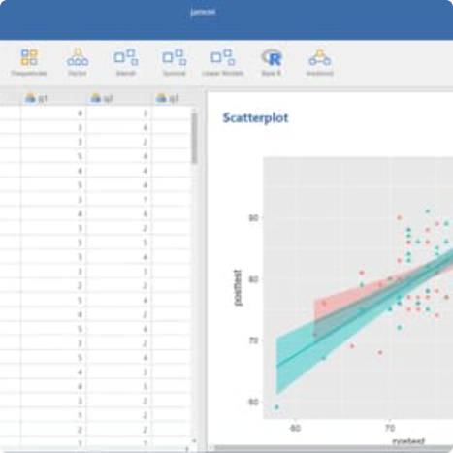
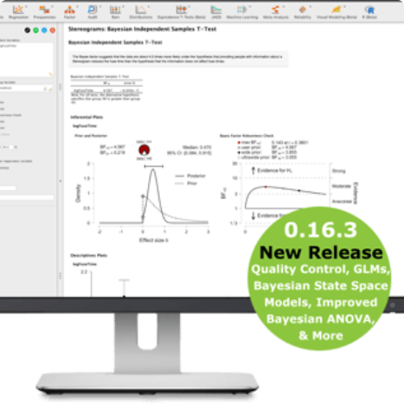
Stand Out in Data Analysis with JASP & Jamovi
Jamovi Software
JASP Software
Learn how jamovi is user-friendly and offers flexible analytical methods for data analysis, making it ideal for individuals at all levels of experience.
Take advantage of JASP software, one of the most powerful data analysis tools available, and use its flexibility for more accurate results.
This section is all about taking your data analysis to the next level using JASP and Jamovi software, two of the most powerful statistical tools available. We'll share some of their strengths and their flexibility that will help you achieve the most accurate results.

Slide 10
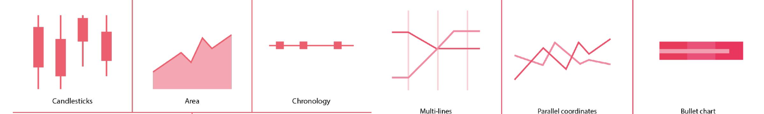
Insights into RawGraphs and SAS OnDemand
1
Advanced Features
2
Explore the Possibilities
3
Differentiating Features
Learn how to navigate and use RawGraphs and SAS OnDemand's advanced features and techniques in data analysis and data visualization.
Explore the endless possibilities of data visualization techniques, from simple to advanced, for an effective data visualization impact.
Finally, we will compare these tools with others, including their differentiating features to gain a better understanding of their strengths and weaknesses.

Slide 11
Improving Your Analysis Skills with BlueSky and Exploratory
Hands-on Session
In this hands-on session, you will learn how to use these two tools effectively for a better analysis result.
1
2
3
Understanding the Role of BlueSky and Exploratory
Compare and Contrast
We will compare BlueSky and Exploratory with other competitors for a well-rounded analysis.
In this section, we will look deeper into BlueSky and Exploratory and understand how to best use them in your data analysis.

Slide 12
Exploring RawGraphs and SAS OnDemand for Advanced Visualization
RawGraphs
SAS OnDemand
Get introduced to the basics of RawGraphs and learn about its advanced data visualization features.
Explore the vast potential of SAS OnDemand, including its capabilities for advanced data analysis and visualization.
In this section, we will dive deep into RawGraphs and SAS OnDemand. We'll explore their advanced data visualization features and capabilities that can help take your data analysis and visualization skills to the next level.

